Slide 1
Credit Risk Modelling: Case Study using R
-Aditya Janardhan

Slide 2
Contents
Introduction
Problem Statement
Solution Design
Solution Implementation
Data Exploration
Data Preparation
Model Creation
Model Validation
Findings and interpretation

Slide 3
Introduction
A credit card company wants to make a model to predict bad customers using the historical data.
The data has details such as demographic data and credit bureau data.
In order to reduce the financial loss, the company only wants to accept only 80% of the applications. The company want to use a suitable model to achieve this.

Slide 4
Solution Design
In the given dataset credit.csv, the target variable ie NPA_Status is binary.
1 is for defaulted customers.
0 is for no- default.
We have a combination of categorical and continuous variables.
We’ll go ahead with Logistic Regression to create the model since the target variable is binary.
We’ll also check Decision trees and compare their efficiencies.
Finally we’ll use the effective model to find the new default rate when the acceptance rate is 80%.

Slide 5
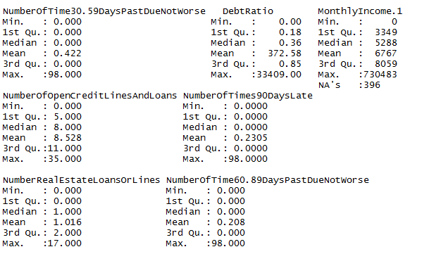
Data Exploration
We use summary to check all the summary statistics to explore the variables and also to find the duplicate values.

Slide 6
Cont.
Assessed the quality of the data by checking for missing values and also the extreme values.
Checked the distribution of various variables by using summary, plotting and tabulation.
Performed sanity check by seeing how many % of customers have defaulted in the data, which in this is approximately 7.7%.
Checked if the variables that we expect to lead to defaults such as late-repayment has relation with actual defaults.
Did anomaly detection such as checking percentage values not exceeding 100 where we don’t expect to.

Slide 7
Data Preparation
Deleted the missing values for Dependents variable.
Replaced the percentage values that has values greater than 1.
Simplified various values across variables such as Defaults by checking tabulation with target variable for convenience in regression. This was done because there were less data points for higher values.
Deleted the outlier values for Monthlyincome variable and imputed the missing values with appropriate method.
Converted simplified values into factor variables.
Split the dataset into Train and Test.

Slide 8

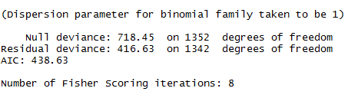
Model Creation
Created Logistic Model on the Train dataset.
Checking the Null deviance, residual deviance and AIC.
We find that we got low values for Null deviance, residual deviance and AIC. Also Residual deviance < Null deviance indicating that we are headed in the right direction.

Slide 9


Cont.
Found the predicted probabilities for Test dataset.
Found the optimum cut-off value by hit-and-trial considering the default rate in the Credit dataset and ensuring high accuracy and sensitivity values because of the priority of the company being minimising the loss.
We use these predicted values for further analysis.

Slide 10
Model Validation
Creating the Confusion matrix.
Accuracy = 473+31/(473+67+9+31) = 86.8%
Sensitivity=31/(31+9)=77.5%+
Specificity=473/(473+67)=87.6%
 | Predicted Non-Events (0) | Predicted Events (1)
Actual Non-Events (0) | True Negatives (473) | False Positives (67)
Actual Events (1) | False Negatives (9) | True Positives (31)

Slide 11
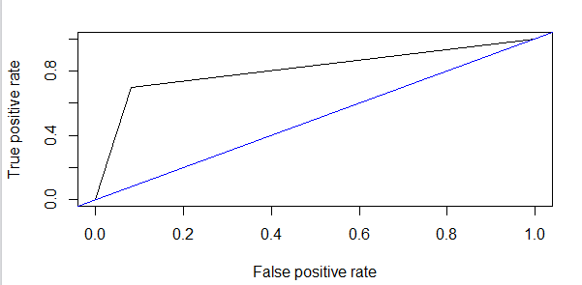
Cont.
Created ROC curve.
It shows a good fit. Thus we will also compute the AUC, which is 0.8255.

Slide 12
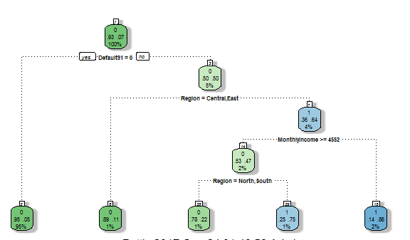
Cont.
Created a Decision tree.

Slide 13
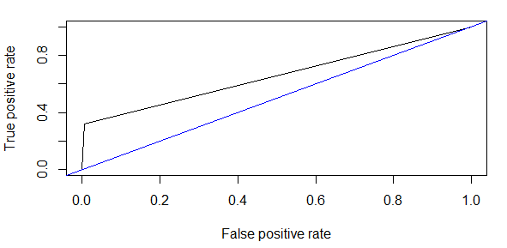
Cont.
Before going further, we check the ROC and AUC and compare it with Logistic model.
Curve for Logistic seems much better. We’ll prove it by computing the AUC which is 0.65684
AUC(Logistic)>AUC(Decision)

Slide 14
Cont.
Therefore, we’ll go ahead with Logistic Model for further interpretation.

Slide 15
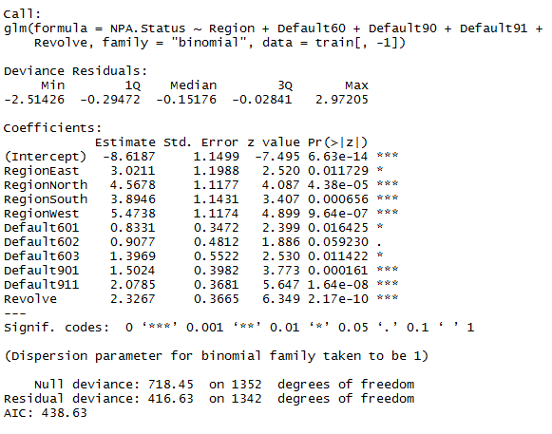
Model Interpretation
Looking out for the significant variables in the Logistic model.

Slide 16
Cont.
The significant variables are Region, Default60, Default90, Default91 and Revolve variables are the significant ones.
For Region variable, when the applicant belongs to East then the log-odds ratio of default increases by 3.02.
When the applicant belongs to West then the log-odds ratio of default increases by 5.47.
We can infer that w.r.t Central all other areas have good chances of defaulting.
If the person has defaulted before in 30-59 days for once then log-odds ratio of default increases by 0.833.
If the person has defaulted before in 30-59 days for thrice or more then thrice the log-odds ratio increases by 1.39.

Slide 17
Cont.
If the there is at least one default in 60-90 days then the log-odds ratio increases by 1.5.
If there is at least one default in more than 90-180 days then the log odds ratio increases by 2.07.
For revolve variable the log-odds ratio increases by 2.32 for every unit increase.

Slide 18

Decreasing the default rate
As the business objective says that we need to reduce the loss by accepting only 80% of the applicants, we use our model to achieve that.
We find the predicted probability of the new dataset of applicants using our logistic model for default and non default.
We take the percentile of probability of 80% as the cut off value. Therefore any value above this will ideally default according to our model.

Slide 19
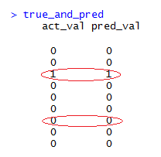
Cont
We find the predicted values now and combine it with actual values of the test dataset.
We compare the predicted non default values by model with the values in actual status column.

Slide 20
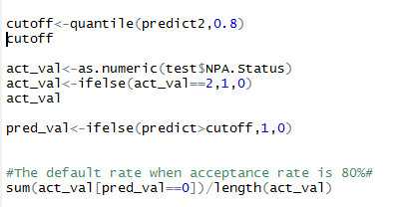
Cont
Use the predicted values assigned by the cut-off set to predict the non defaulters. Then we find the default rate.
The default rate now is 1.55% on our Test dataset. Thus we have successfully reduced the default significantly using the model compared to 7.2% in the original dataset.

Slide 21
Recommendations
The applicants from Central region are very less likely to default compared to other regions such as North, South. Therefore a little bit of leniency could be permitted
The applicants from West region are more highly likely to default, therefore more scrutiny into the applicants would be recommended before approving.
The default payment history has to be studied carefully for each applicant. The chances of default increases depending on the number of defaults and also the delay in days on payments.
The balance ratio of credit balance and permitted withdrawal amount should be checked carefully because higher the ratio higher are the chances to default.

Slide 22
Thank You!

